Slide 1
CSE 4128
Lab 4
Frequency Domain Filtering
Dr. Sk. Md. Masudul Ahsan
Professor,
Dept. of Computer Science and Engineering,
KUET
Dipannita Biswas
Lecturer,
Dept. of Computer Science and Engineering,
KUET
Kaniz Fatema Isha
Lecturer,
Dept. of Computer Science and Engineering,
KUET

Slide 2
2D Discrete Fourier Transform
Represents an image in a frequency domain where the original image is represented in spatial domain.
2D DFT converts image into a complex array that consists of :
Spectrum
Phase Angle

Slide 3
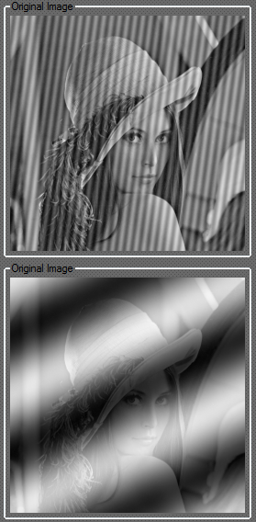
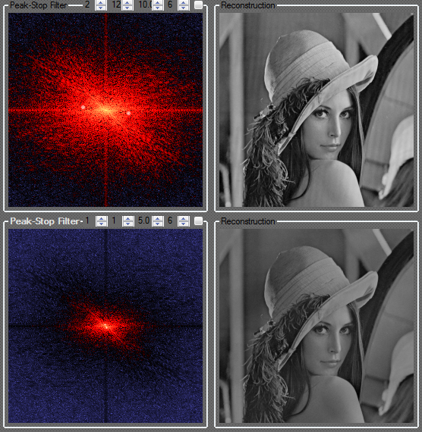

Slide 4
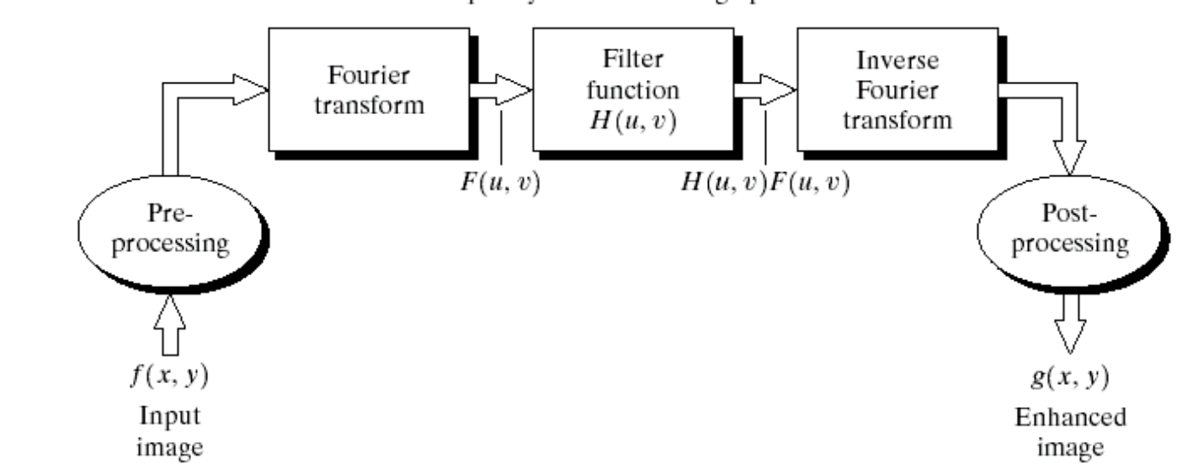
Basics of Filtering in the Frequency Domain
To filter an image in the frequency domain:
Compute F(u,v) the DFT of the image
Multiply F(u,v) by a filter function H(u,v)
Compute the inverse DFT of the result

Slide 5
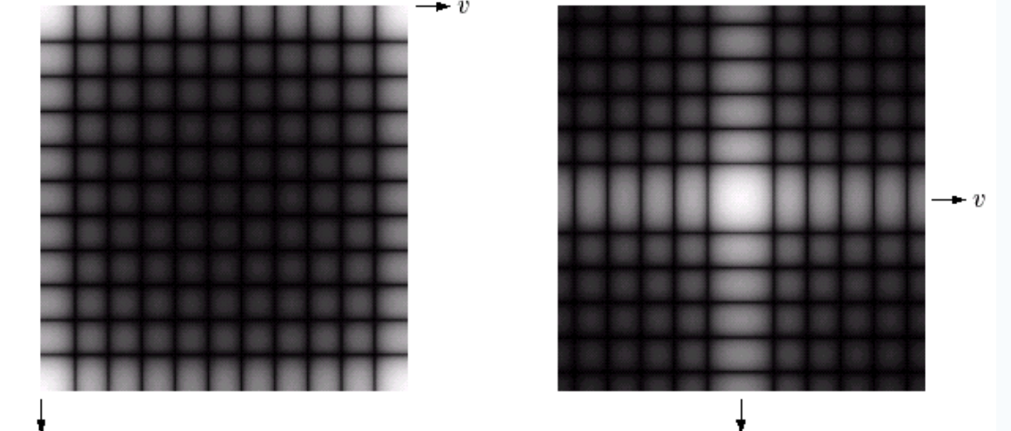
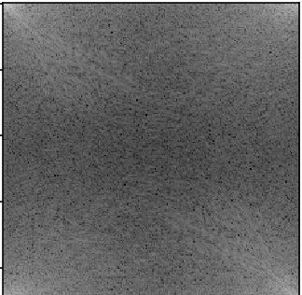
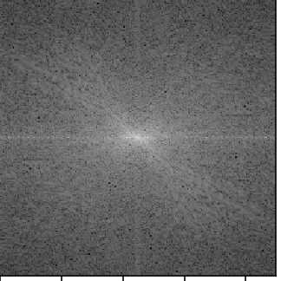
Basics of Filtering in the Frequency Domain
Spectrum moved into the centre

Slide 6
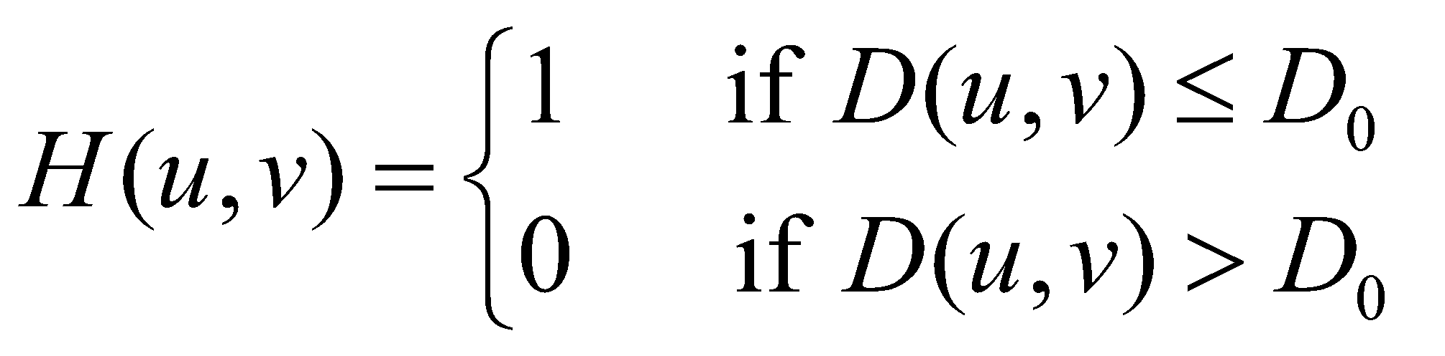
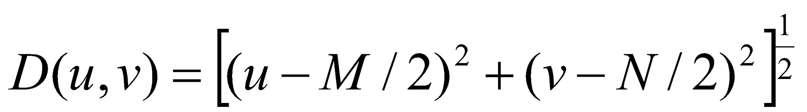
Notch Filter
A notch filter rejects (or passes) frequencies in a predefined neighborhood about the center of the frequency rectangle.
Ideal low pass filter “cuts off” all high-frequency components of the Fourier transform that are at a distance greater than a specified distance D0 from the origin of the transform.
where D(u,v) : the distance from point (u,v) to the center of their frequency rectangle

Slide 7
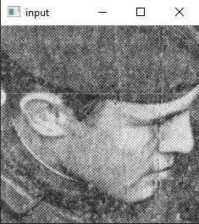
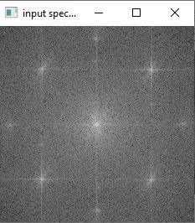
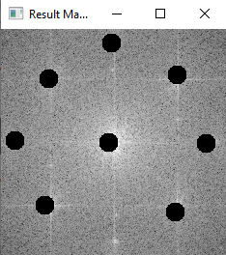
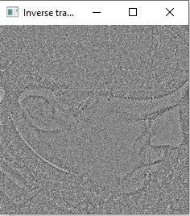
Classwork
Ideal low pass notch filter - where the value of D0 is chosen dynamically using mouse click

Slide 8
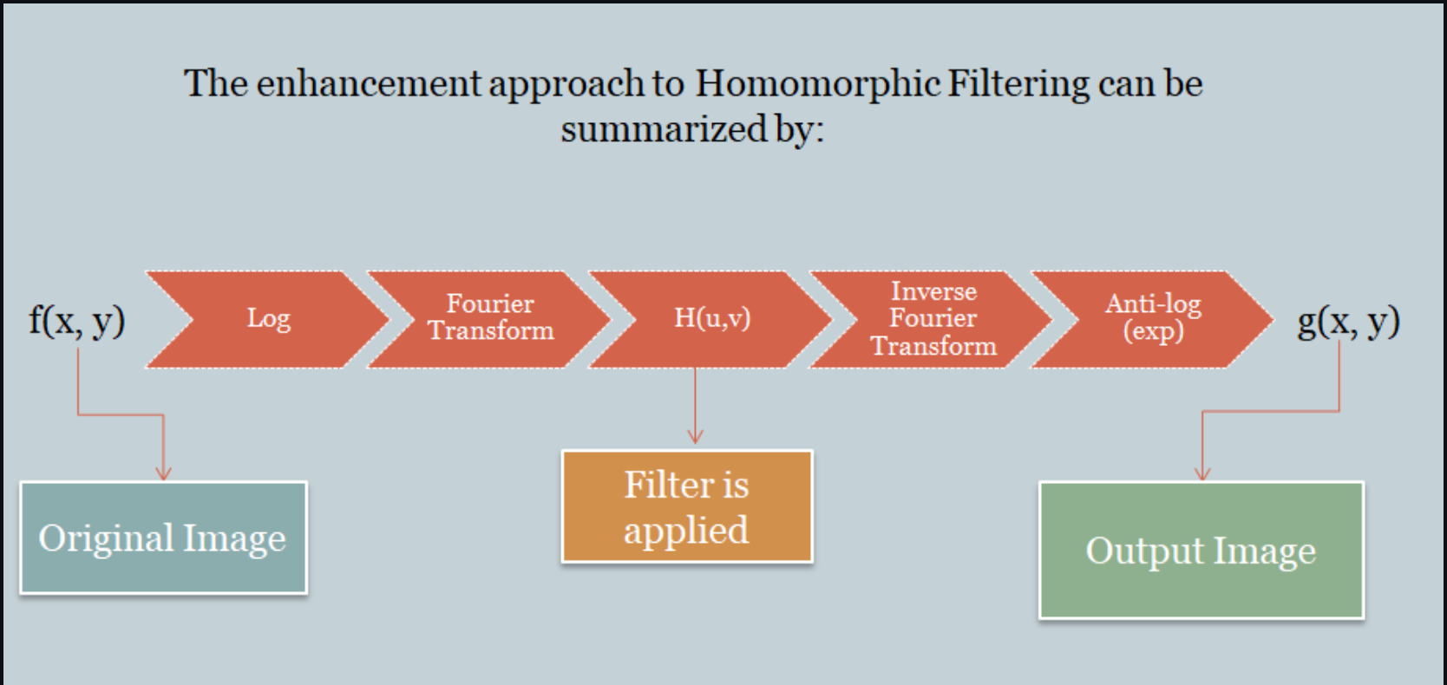
Assignment
Homographic Filtering - a technique for improving the appearance of an image by simultaneous gray-level range compression and contrast enhancement

